Slide 1
CS 355/555
Probability and Statistics for CS
Baocheng Geng
03/26/2024
CS 355/555 Probability and Statistics for CS

Slide 2
Copyright Statement
Copyright Statement
Materials prepared for and/or included in this course are protected by copyright law. They are intended to be used only by students enrolled in this course during the current term and should not be further disseminated without prior permission from the course instructor.
CS 355/555 Probability and Statistics for CS

Slide 3
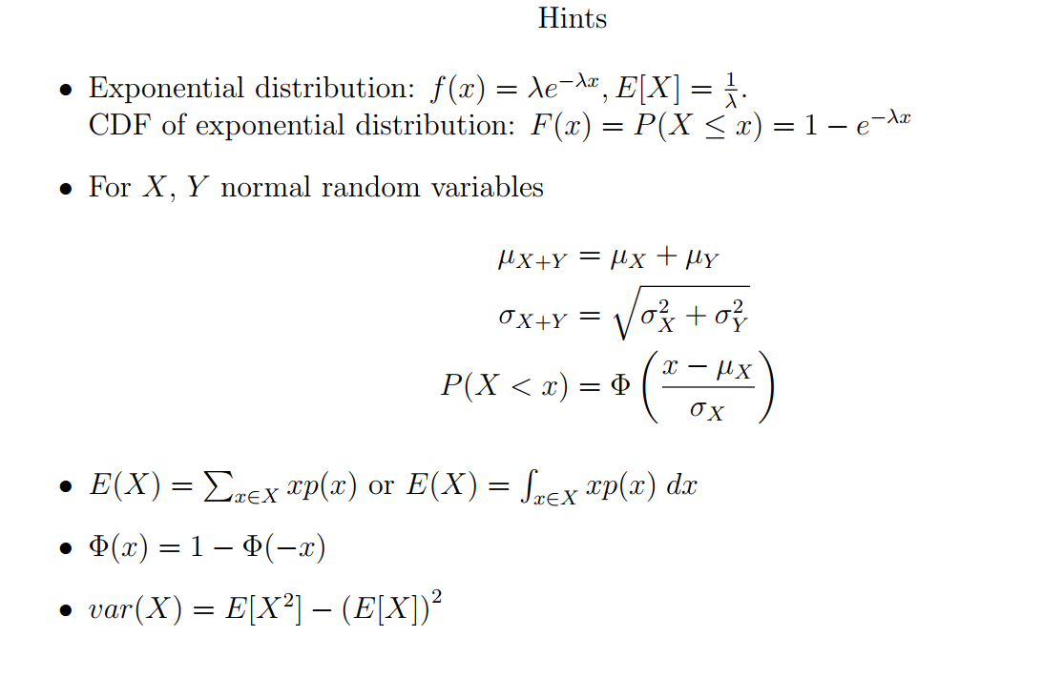
Sample Test
CS 355/555Probability and Statistics for Computer Scientists

Slide 4
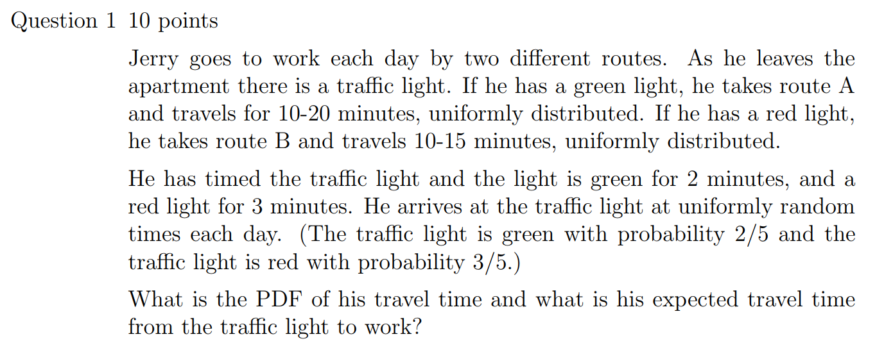


Sample Test
CS 355/555Probability and Statistics for Computer Scientists

Slide 5
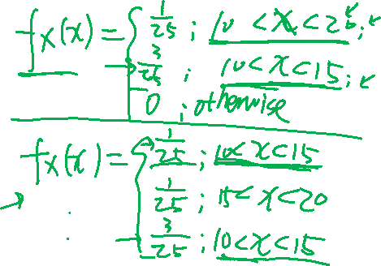

Slide 6
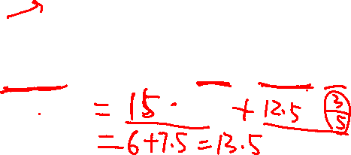
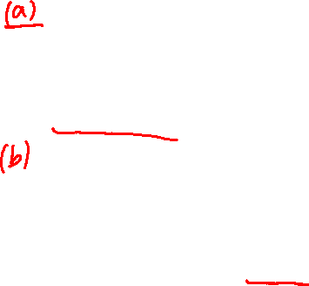


Slide 7
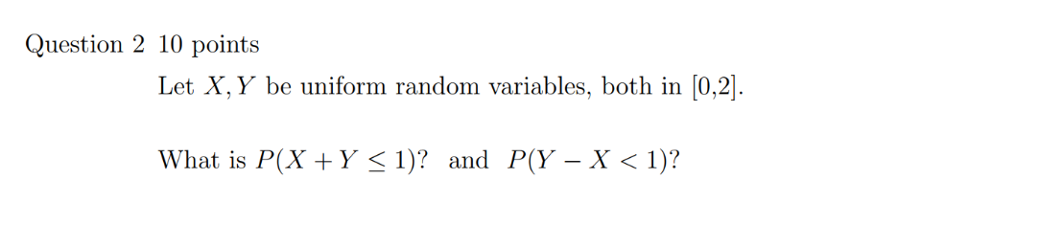

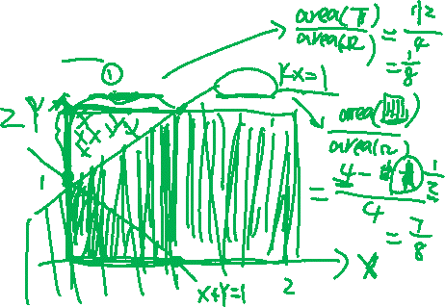
Sample Test
CS 355/555Probability and Statistics for Computer Scientists

Slide 8
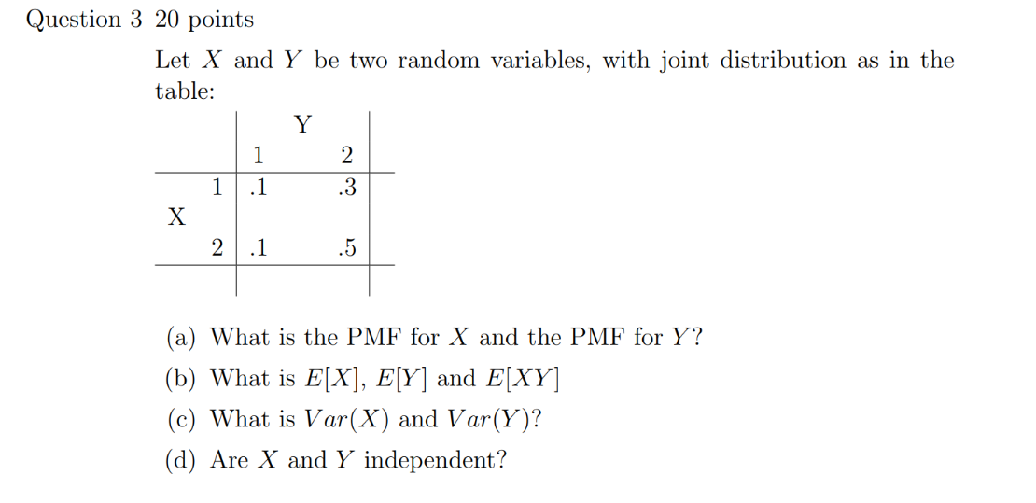

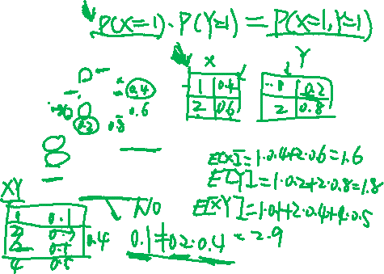
Sample Test
CS 355/555Probability and Statistics for Computer Scientists

Slide 9
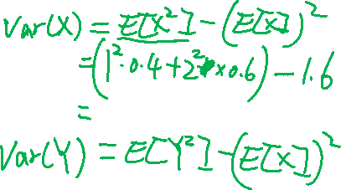

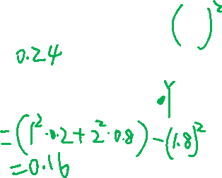

Slide 10
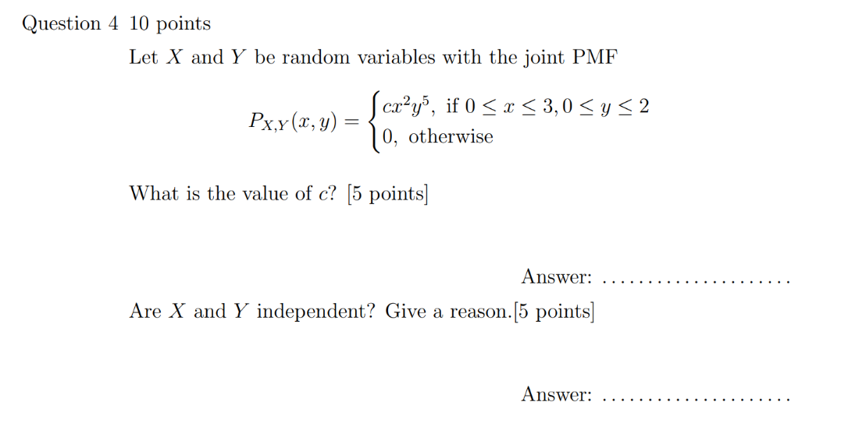
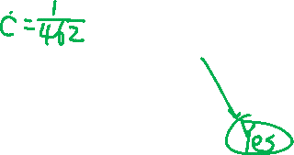
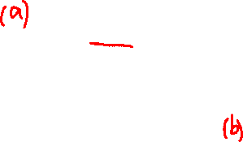
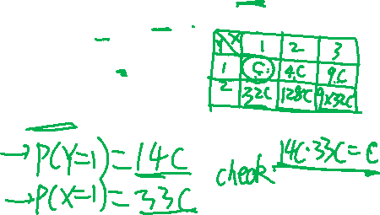
Sample Test
CS 355/555Probability and Statistics for Computer Scientists

Slide 11
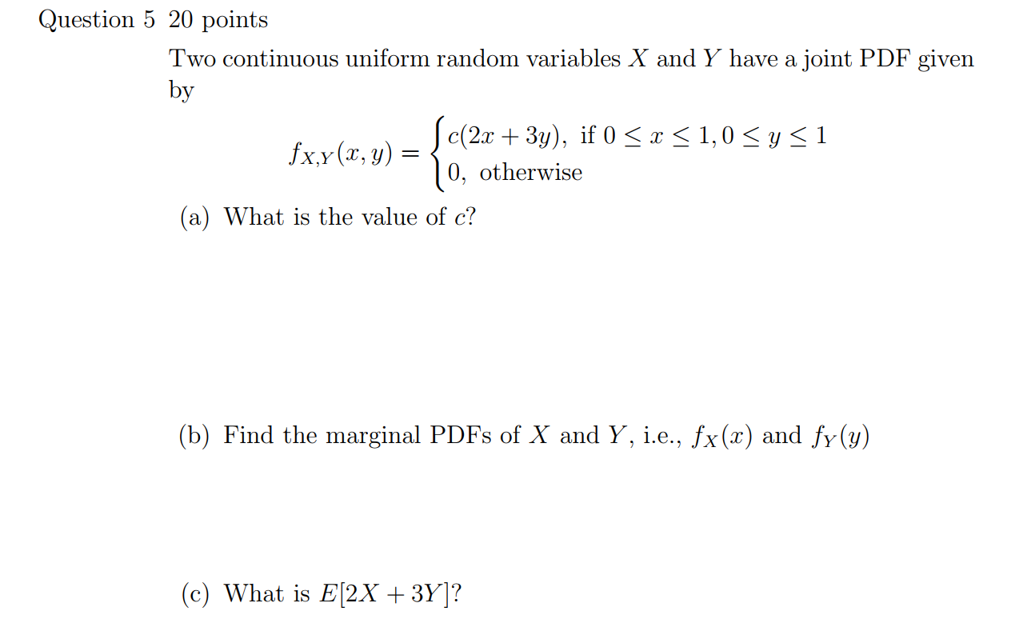
Sample Test
CS 355/555Probability and Statistics for Computer Scientists

Slide 12
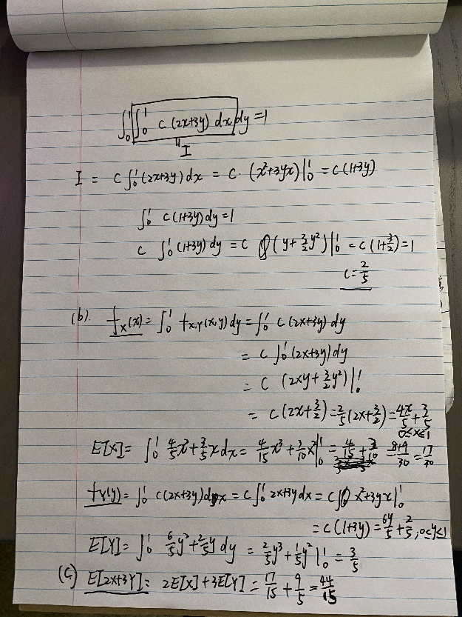

Slide 13
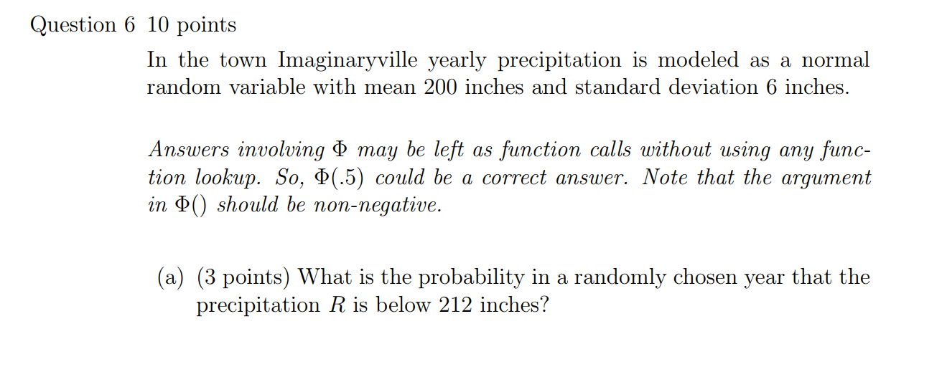
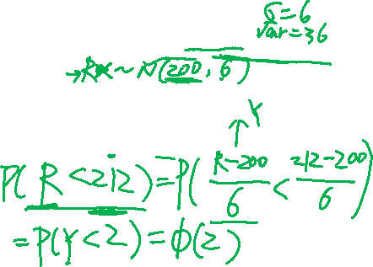
Sample Test
CS 355/555Probability and Statistics for Computer Scientists

Slide 14
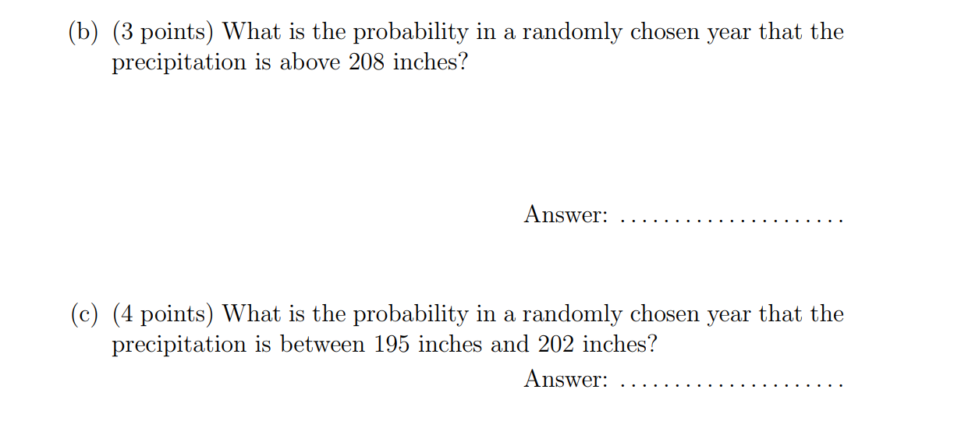
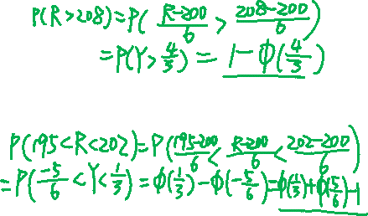
Sample Test
CS 355/555Probability and Statistics for Computer Scientists

Slide 15
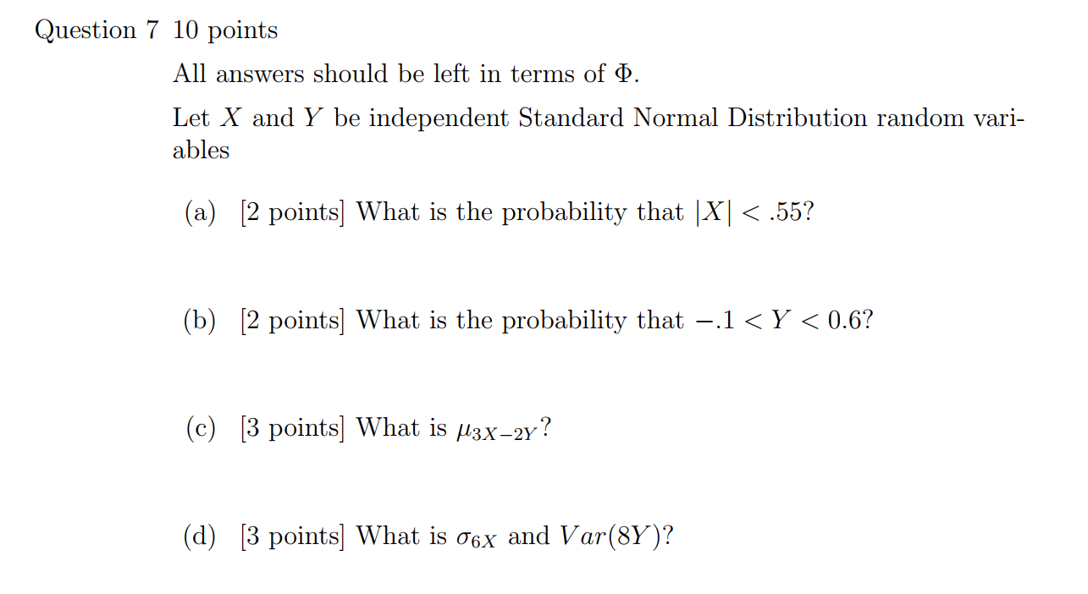

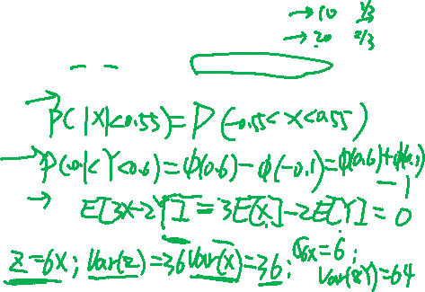
Sample Test
CS 355/555Probability and Statistics for Computer Scientists

Slide 16
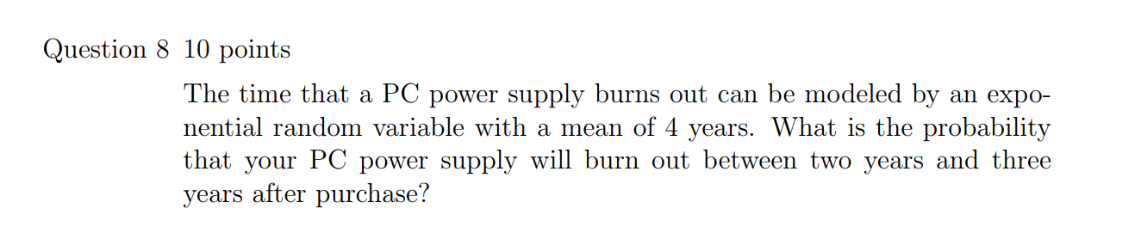
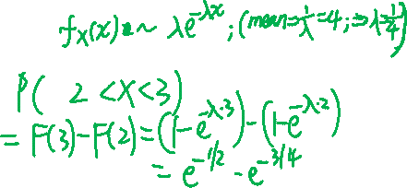
Sample Test
CS 355/555Probability and Statistics for Computer Scientists

